Slide 1

Sound
Kit Martin

Slide 2

Key Facts
In physics, sound is a vibration that propagates as an acoustic wave, through a transmission medium such as a gas, liquid or solid.
In human physiology and psychology, sound is the reception of such waves and their perception by the brain.
Only acoustic waves that have frequencies lying between about 20 Hz and 20 kHz elicit an auditory percept in humans.
Sound waves above 20 kHz are known as ultrasound and are not audible to humans. Sound waves below 20 Hz are known as infrasound.
Different animal species have varying hearing ranges.

Slide 3
Model Idea
Originally, wanted a model of a person perceiving sound
New idea to expand theory building was to add in the model of particle collisions

Slide 4

Scope of Work
We want students to be able to select either spring or billiards when they build their model.
Initially, they're exploring it in a microworld exploration.
We aim to provide one model that has both springs and billiards possible, and they put that into the setup and we see how possible it is to put models into one NetTango environment.

Slide 5
Things the model could help theorize
Acoustics
Physics of sound
Perception of sound
Sound pressure level
Ultrasound
Infrasound

Slide 6
Acoustics

Slide 7
Definition

Slide 8
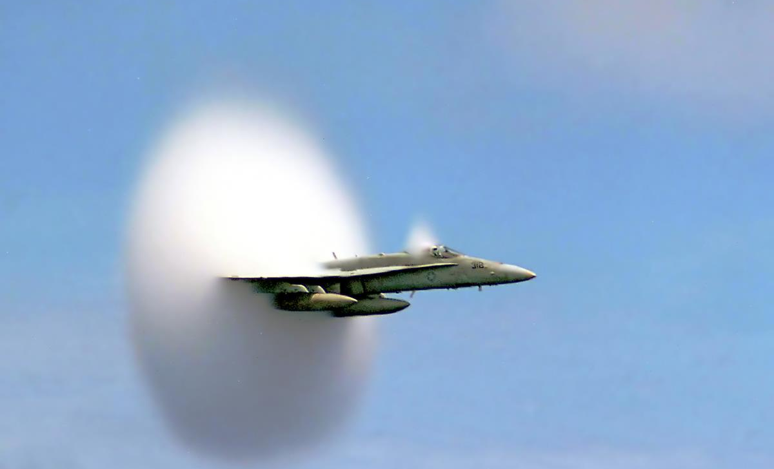
Physics of sound
Longitudinal and transverse waves
Sound wave properties and characteristics
Speed of sound
Notes:
Consider talking about:
Longitudinal and transverse waves
Sound wave properties and characteristics
Speed of sound

Slide 9
Perception of sound
Pitch
Duration
Loudness
Timbre
Sonic texture
Spatial location
Notes:
Consider talking about:
Pitch
Duration
Loudness
Timbre
Sonic texture
Spatial location

Slide 10
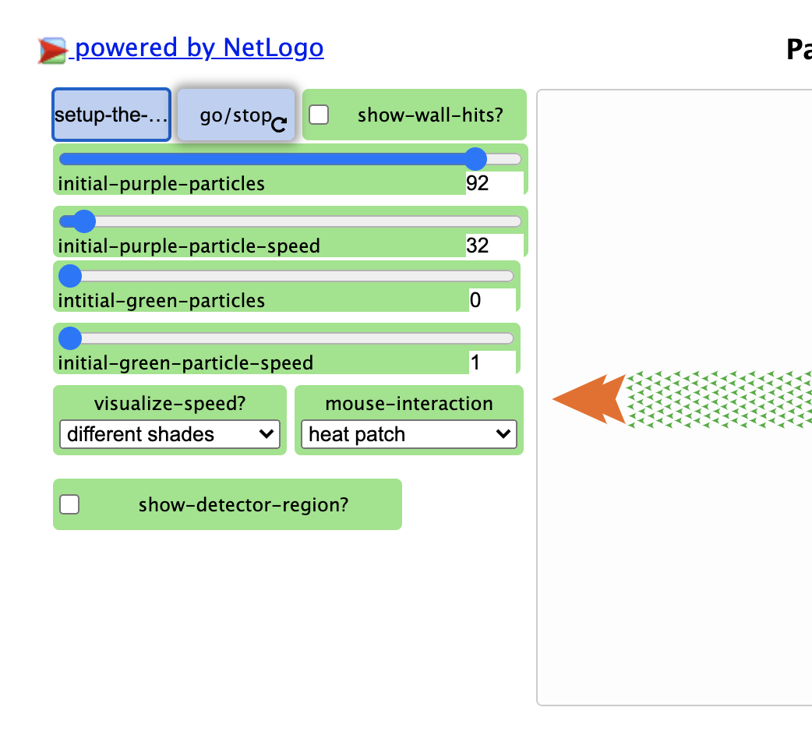
The Model

Slide 11

Current Limitations
Model Complexity
NetTango Block Simplicity
Can’t download the model

Slide 12
The Model is Complex
There are two main actions, that combined result in 1,200 lines of code.
Main Actions:
Billiard balls
Springs
Here code complexity and model complexity are conflated, still sussing out the difference for myself

Slide 13
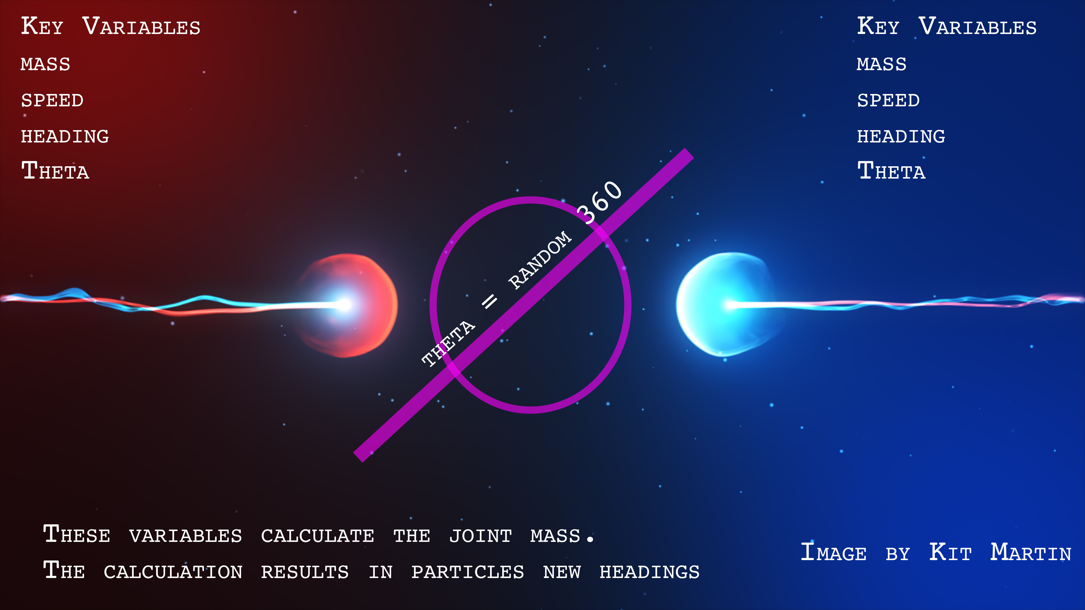
Billiard Balls
‘

Slide 14

Key Variables
Velocity
Stiffness
Z coordinate
Neighbors in a cross
Springs

Slide 15

Key Variables
Velocity
Stiffness
Z coordinate
Neighbors in a cross
Springs

Slide 16
NetTango Block Simplicity
Particle models have limited blocks. Due to the fact all action takes place at the meso level—that is above the individual agent level but below the macro-level pattern—the individual agent blocks are exceedingly simple.
Here code complexity and model complexity are also conflated, still sussing out the difference for myself.

Slide 17

Can’t update graphs or graphics
I can’t update the graphs, or icons at the moment.
When I download the NetLogo file it gives an error:
“ASK expected input to be an agent or agentset but got NOBODY instead.”

Slide 18
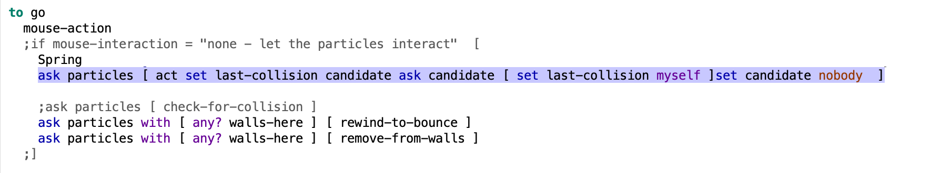
Located in this area of code
Candidate is not defined,
when I take it out of NetTango

Slide 19
Conclusion
It’s a work in Progress
Hopefully, the ideas in this meeting better refine the goal

Slide 20
Sound pressure level

Slide 21
Ultrasound

Slide 22
Infrasound

Slide 23
Works cited

